Slide 1
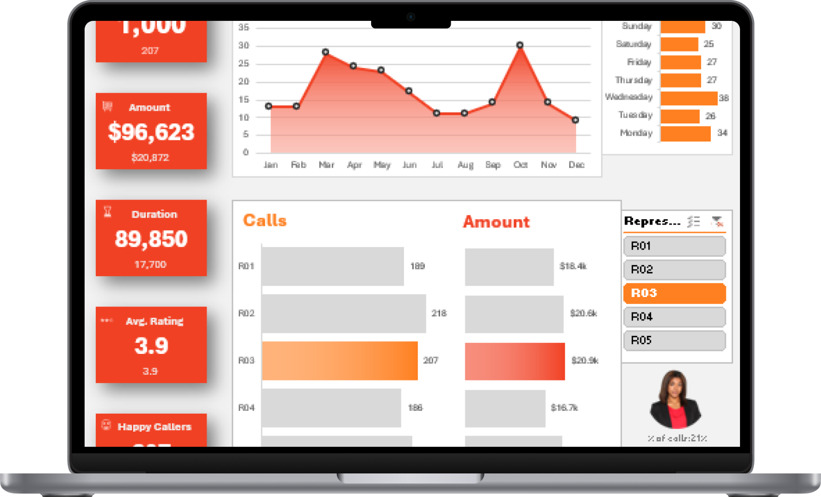
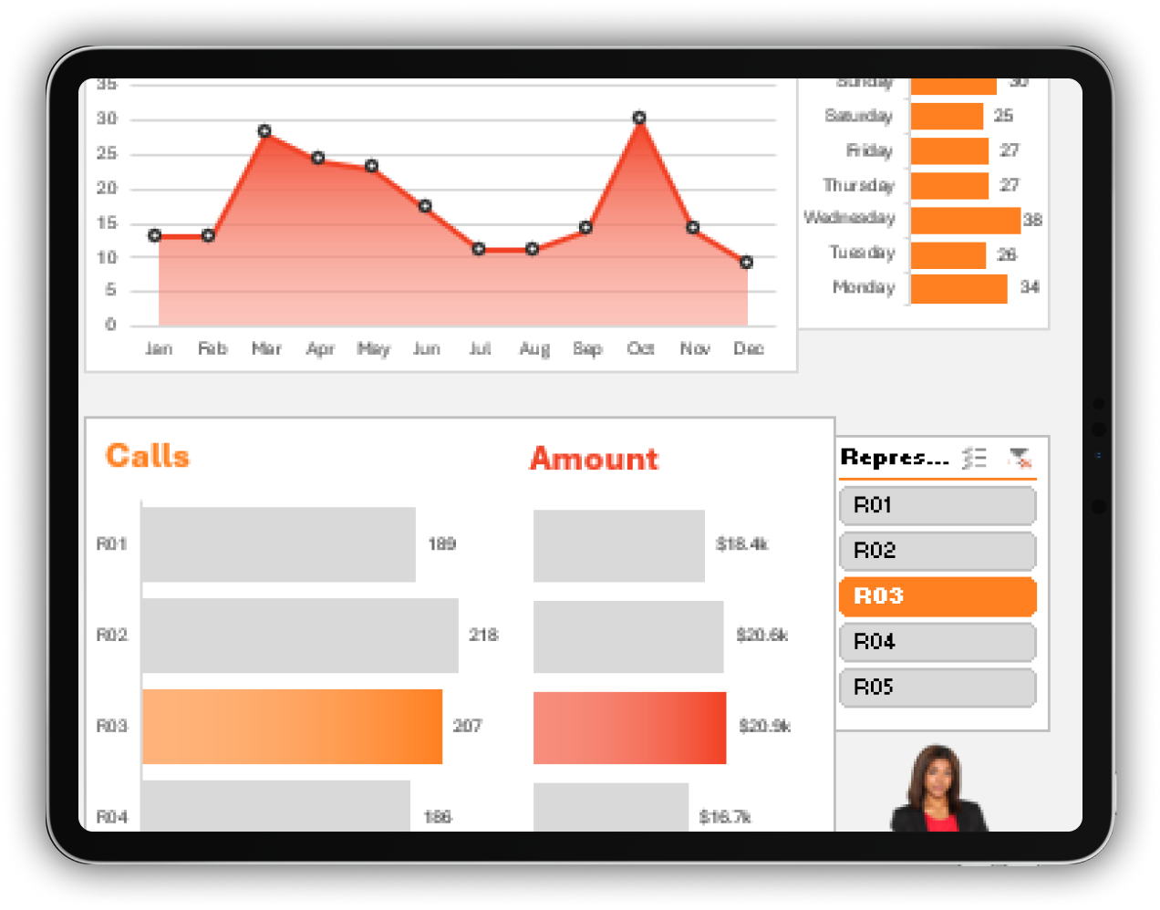
Hi,
I’m Mohammed Saqib
I’m Mohammed Saqib

Slide 2
About me
With my 1.5 + years of experience as an Associate Software Engineer at Tricon Infotech, where I ensured in resolving production issues with SQL. I led my team in prioritizing tasks, ensuring timely delivery of stakeholder requirements, and collaborated with my manager to create reports that improved customer satisfaction by analyzing trends. Additionally, I have completed certifications from Udemy, LinkedIn, and Codebasics to enhance my data analysis skills.

Slide 3
Agenda
1
Problem Statement
2
General Data Analysis Process
3
Excel Techniques used in the Project
4
Insights from KPI’s
5
Findings
6
What I learned from this project ?

Slide 4
Problem Statement
Excel Project
Client wanted to understand the essential Key Performance Indicators from the to be obtained in the customer representative dataset as mentioned below

Slide 5
Data Analysis Process Used
Excel Project
Analyzing the Problem Statement
Data Collection/Import
Data Cleaning
Data Processing
Sharing Insights
Data Visualization
Utilisation of Excel Techniques

Slide 6
Excel Techniques used in the Project:
Excel Project
Use of Data Cleaning techniques (Handling missing data, Remove Duplicates)
Use of DAX formulas to create measures required for KPI in Excel
Use of Conditional Formatting in Excel
Use of Data visualization techniques such as Excel

Slide 7
Insights from the Project:
Excel Project
Github Link

Slide 8
Findings:
Excel Project
Out of 1000 calls throughout the year, the total number of happy callers are 307 which accounts to 30.7% of the total calls.
The Average Call Rating is of 3.9
The Highest call received where in the month of March
The Most Amount was generated by the Representative (R05) which is around 20,900 dollars

Slide 9
My takeaways from the Project:
From the analysis, the company can focus on necessary measures to take in improving the happy call rates and provide the utmost customer satisfaction.
By increasing the happy customer satisfaction rate, they can also improve the average rating of the calls.
Since the Highest sales were in the month of March, we can further conduct a in depth analysis of what brought this huge sale trend during that particular time and how we can generate more sales based on the analysis.
My learning from the project is that I have learned how to obtain in data insights in the customer domain and also how we can incorporate the use of Pivot Tables and measures to get the valuable insights.

